Slide 1
Explore compute and storage options for data engineering workloads

Slide 2
Agenda
Data engineering tools
Describe Azure Databricks
Introduction to Azure Data Lake storage
Describe Delta Lake architecture
Indexing with Hyperspace
Notes:
TALKING POINTS
Let’s set an agenda for today’s presentation in which we are going to discuss these topics.
PRESENTER NOTES AND GUIDANCE
Don’t take too much time in order to present the agenda. Make the points in the topics.

Slide 3
Data engineering tools
1

Slide 4

A data engineer’s toolbox and skillset
ETL/ELT tools
Data exploration & management tools (SSMS, Azure Data Studio, Storage Explorer, etc.)
Query languages such as SQL
Python
Spark/Hadoop
HDFS & data lakes
Visualization & BI tools
Notes:
Just talk briefly and at a high level about the basics of the tools involved. We will dive deeper into these tools throughout the workshop and labs.
Mention the various tools we have in Azure:
ETL tools
SQL Server Integration Services (SSIS)
ADF / Synapse pipelines
Data exploration & management tools
SQL Server Management Studio (SSMS)
Azure Data Studio
Azure Storage Explorer
Azure Data Explorer
Synapse Analytics serverless SQL pool
Languages
SQL
Scala
Python
C# (in Synapse)
R
Spark/Hadoop
Databricks
Synapse Spark
HDInsights
Storage
ADLS Gen2
Visualization
Power BI
Notebook visualizations in Databricks and Synapse Spark

Slide 5



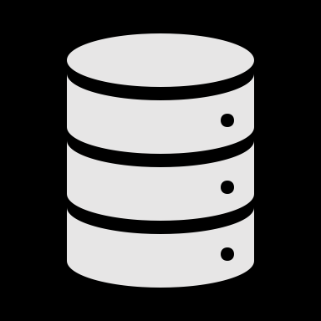


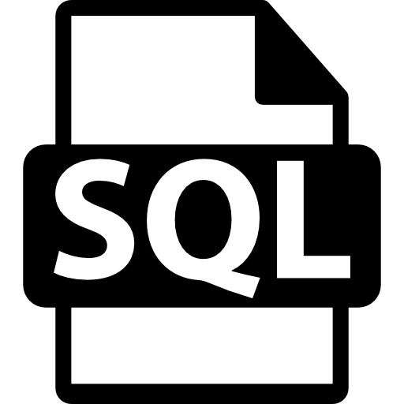

ETL on Azure
You’ve got to move it move it!
Azure Data Factory
SQL Server Integration Services (SSIS)
HDInsight with Hive
Oozie on HDInsight
Azure Databricks
SQL with PolyBase or COPY activity
Synapse Analytics pipelines
Notes:
Azure Data Factory – 95+ connectors, visual design with low code, PaaS option
SSIS – ETL tool traditionally used with on-premises SQL Server. Most SSIS packages can be hosted in Azure Data Factory
HDInsight with Hive – Data warehouse system for Hadoop. It enables data summarization, querying, and analysis. Hive queries are written in HiveQL, similar to SQL
Oozie on HDInsight – Workflow and coordination system that manages Hadoop jobs. Oozie is integrated with the Hadoop stack and supports MapReduce, Pig, Hive, and Sqoop. It can schedule jobs specific to a system, like Java programs or shell scripts
Azure Databricks – Powerful managed Spark PaaS service. You can create schedule jobs, call Databricks notebooks from external services like ADF or Synapse, and programmatically execute notebooks or modules from a number of solutions.
SQL with PolyBase or COPY activity – Access files stored in your data lake and load them into your data warehouse by using PolyBase or COPY activities for efficient data movement. You can do this from SSMS, Azure Data Studio, or data pipeline and integration tools like ADF.

Slide 6
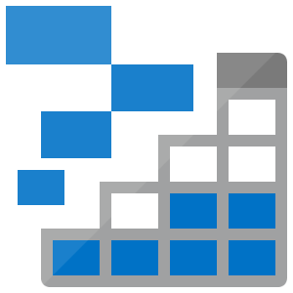
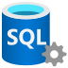

Data exploration, management, and transformation
This is a big (data) lake. Should have brought a bigger boat!
Azure Storage Explorer
Azure Data Studio / SSMS
HDInsight
Azure Databricks
Synapse Analytics
Notes:
Azure Storage Explorer – Desktop application makes it fast and easy to manage Azure storage accounts and upload multiple files through a visual interface.
Azure Data Studio / SSMS – Desktop applications that allow you to manage, manipulate, and explore various types of databases. Azure Data Studio adds extensions to do things like work with notebooks. You can also explore the data lake with SQL when you use PolyBase.
Azure Databricks –
Synapse Analytics – Synapse Spark and serverless SQL pools enable you to efficiently explore, manage, transform, and load your data.

Slide 7

“Now we have a new problem… I have to set up and manage several tools and environments to do my job!”
- Internal monologue
Notes:
These problems are what set data engineers apart from DBAs, data analysts, and data scientists. As data engineers, we need to be proficient in many tools and technologies to build data pipelines, integrate systems, and meet the needs of many who rely on this valuable data.

Slide 8
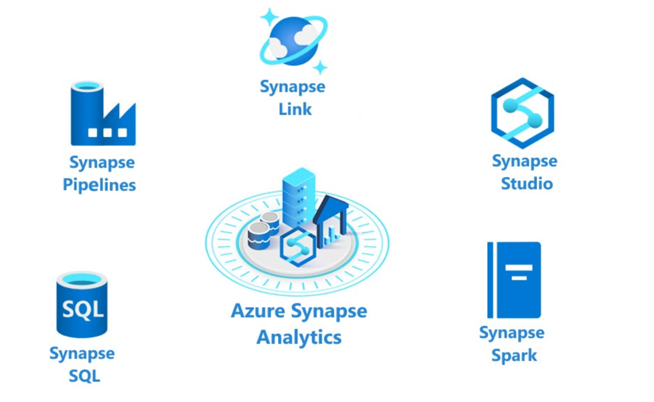

Synapse Analytics to the rescue!
Data Explorer
Notes:
The following components are available in Azure Synapse Analytics:
- Analytics capabilities are offered through Synapse SQL through either dedicated SQL pools or serverless SQL pools.
- Apache Spark pool with full support for Scala, Python, SparkSQL, and C# with Synapse Spark
- Data Integration & Orchestration to integrate your data and operationalize all of your code development with Synapse Pipelines
- Perform operational analytics with near real-time hybrid transactional and analytical processing with Azure Synapse Link.
- Use Synapse Studio to access all of these capabilities through a single Web UI

Slide 9
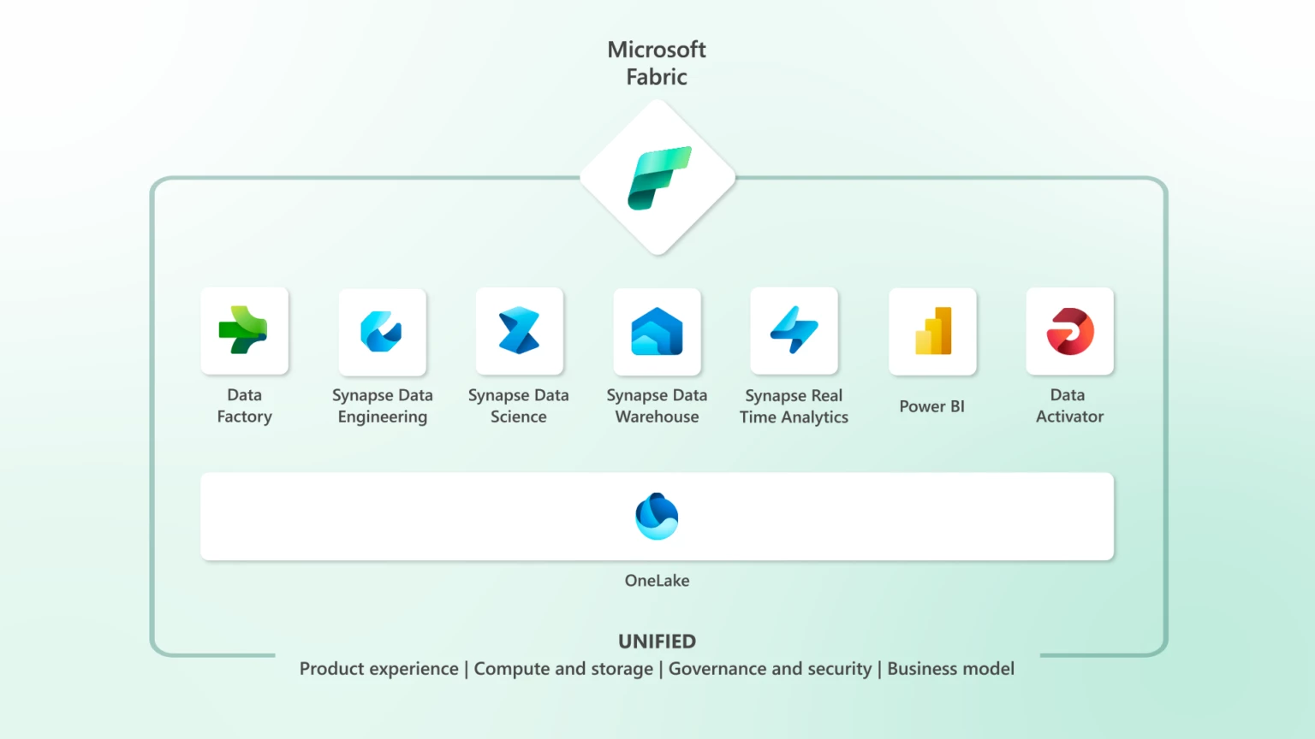
Notes:
Next generation of Synapse… Microsoft Fabric.

Slide 10
Describe Azure Databricks
2
Notes:
TALKING POINTS
Let’s go over fundamental data modeling for optimizing analytical workloads. How many of you have heard of a star or snowflake schema?
PRESENTER NOTES AND GUIDANCE
Poll your audience.

Slide 11
What is Azure Databricks?
Apache Spark-based analytics platform:
Simplifies the provisioning and collaboration of Apache Spark-based analytical solutions dealing with batch and streaming data
Comprehensive Spark library support:
Support includes SQL, DataFrames, MLlib, Hyperspace and MSSparkUtil
Enterprise Security:
Utilizes the security capabilities of Azure
Integration with other Cloud Services:
Can integrate with a variety of Azure data platform services and Power BI
Notes:
Talking points
Azure Databricks is a managed Spark as a Service propriety solution that provides an end-to-end data engineering/data science platform as a solution. Azure Databricks is of interest for Data Engineers and Data Scientists, working on big data projects daily because it provides the whole platform in which you have the ability to create and manage the big data/data science pipelines/projects all on 1 platform.
It is likely that you may have students that use Azure Databricks already. One of the common questions that is asked by customers is whether Azure Databricks can work with Azure Synapse Analytics. The answer is yes. There are example of customers who use Azure Databricks for the Spark capabilities, and Azure Synapse Analytics for the data warehousing, integration and visualization capabilities successfully.
Recommended reading for this slide
Describe Azure Databricks - Learn | Microsoft Docs
Spark architecture fundamentals - Learn | Microsoft Docs

Slide 12
Introduction to Azure Data Lake storage
3

Slide 13

So, what is a data lake and why is it such a big deal?
Notes:
A data lake is a storage repository that inexpensively stores a vast amount of raw data, both current and historical, in native formats such as XML, JSON, CSV, and Parquet. It may contain data from operational relational databases with live transactional data.
When you deal with lots of data coming in at different speeds from different sources in different formats, you need a place to land it all. Data lakes are very cost-effective, allowing us to store data in its various states and forms, for very long periods of time. Like forever.

Slide 14
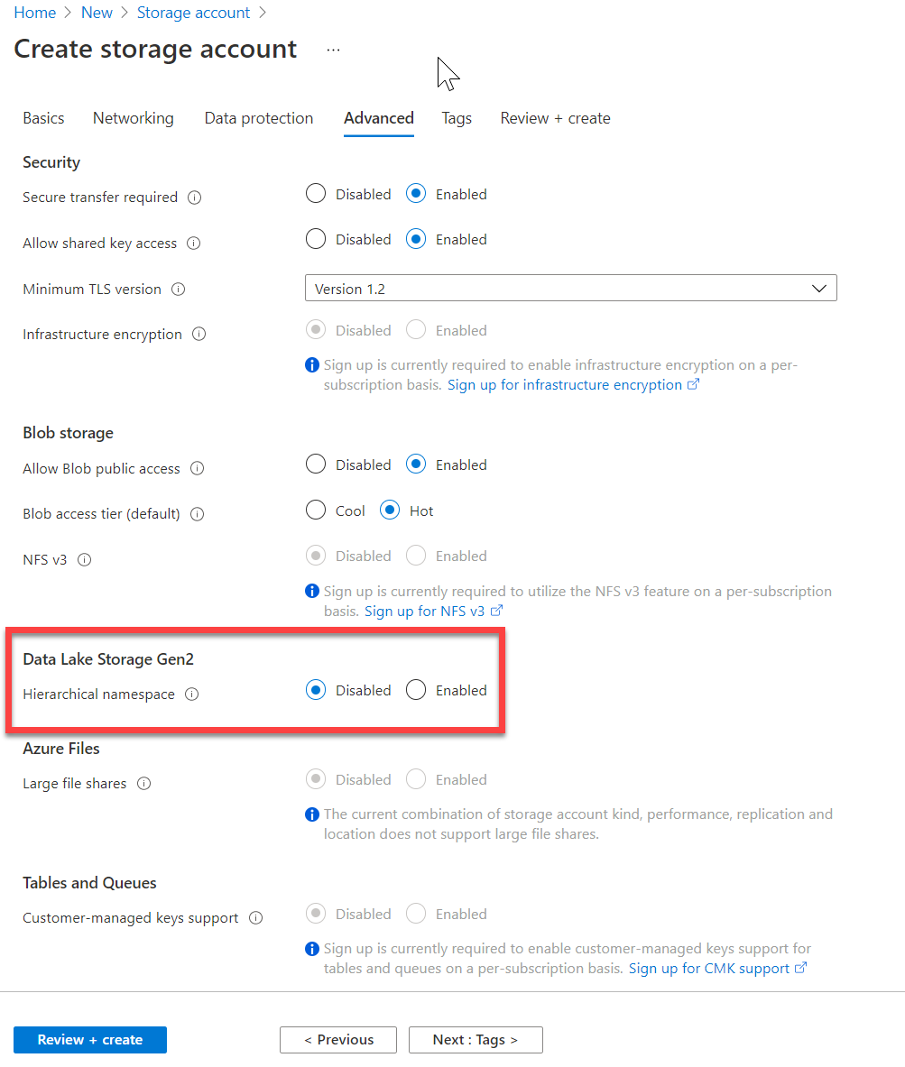
Introduction to Azure Data Lake Storage (ADLS)
Hadoop compatible
Security
Performance
Redundancy
Notes:
Talking points
The first point of “Hadoop Access” is a key differentiator for using Azure Data Lake Storage Gen2 (ADLSG2) over Blob storage.
Coupled with the security model that provides very granular permissions, this makes ADLSG2 a compelling data storage tier for a range of Azure data platform technologies including Azure Synapse and Azure Databricks.
The ability to perform big data analytics is critical and the performance of ADLSG2 helps with that performance.
All of this comes with the Geo redundancy capability to ensure that the data is safe.
Instructor notes and guidance
This will be the only module where we cover Azure Data Lake store in depth, and it is the reason why the lab focuses so much on how the data lake can be optimized while using the compute technologies. As a result, you can spend some time on the list in the slide, and ultimately state to the students that all this is achieved with a single selection of a radio button when you create a storage account.
Recommended reading for this slide
Introduction to Azure Data Lake storage - Learn | Microsoft Docs

Slide 15
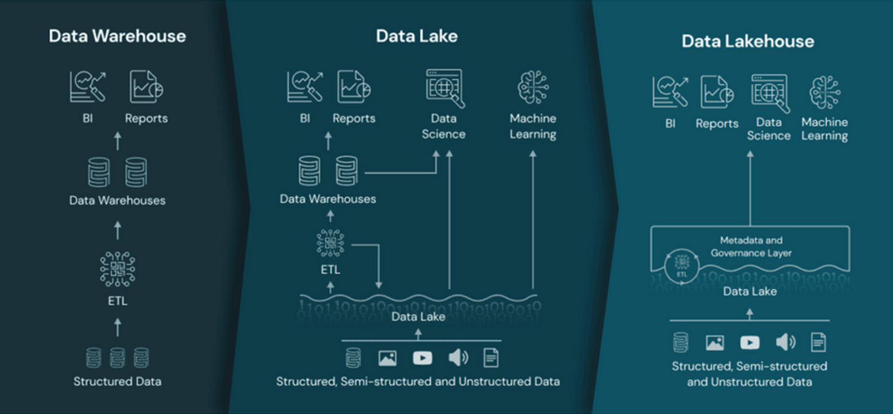
Data Lakehouse
Notes:
At the core of the Intelligent Data Platform architecture is a data lakehouse. Built upon the enterprise data lake, it acts as the underlying data storage and serving layers, allowing reporting and business intelligence (BI) tools to interact with curated data quickly and securely directly from the data lake. This foundational component addresses the limitations of data lakes by providing an open architecture that implements similar data structures and data management features to those in a data warehouse directly on top of the data lake. This approach can help to lower costs by reducing data duplication and eliminating additional ETL processes and can also help with data staleness issues typical of data warehouse solutions, as data is accessed directly from the data lake.

Slide 16
Organizing data in the data lake
Separate storage accounts for each environment: dev, test, & production.
Use a common folder structure to organize data by degree of refinement.
ADLS Gen 2 Filesystem
Raw Data
/bronze
Query Ready
/silver
Report Ready
/gold
Notes:
The first thing we should consider as we look at ingesting data into the data lake is how to structure or organize data within the data lake.
The recommendation for structuring folders to manage the data at the various levels of refinement in the data lake is as follows:
You should use Azure Data Lake Store (ADLS) Gen2 (Within the Azure portal, this is an Azure Storage account with a hierarchical namespace enabled).
A key mechanism that ADLS Gen2 to provide file system performance at object storage scale and prices is the addition of a hierarchical namespace. This allows the collection of objects/files within an account to be organized into a hierarchy of directories and nested subdirectories in the same way that the file system on your computer is organized. With a hierarchical namespace enabled, a storage account becomes capable of providing the scalability and cost-effectiveness of object storage, with file system semantics that are familiar to analytics engines and frameworks.
In ADLS, it is a best practice to have a dedicated Storage Account for production, and a separate Storage Account for dev and test workloads. This will ensure that dev or test workloads never interfere with production.
A common method for structuring folders within a data lake is to organize data in separate folders by the degree of refinement. For example:
Bronze tables contain raw data ingested from various sources (JSON files, RDBMS data, IoT data, etc.).
Silver tables will provide a more refined view of our data. We can join fields from various bronze tables to enrich streaming records, or update account statuses based on recent activity.
Gold tables provide business level aggregates often used for reporting and dashboarding. This would include aggregations such as daily active website users, weekly sales per store, or gross revenue per quarter by department.
Important to note:
When data is stored in Data Lake Storage Gen2, the file size, number of files, and folder structure have an impact on performance. The following section describes best practices in these areas.
If you store your data has many small files, this can negatively affect performance. In general, organize your data into larger sized files for better performance (256MB to 100GB in size).
Some engines and applications might have trouble efficiently processing files that are greater than 100GB in size.
Sometimes, data pipelines have limited control over the raw data which has lots of small files. It is recommended to have a "cooking" process that generates larger files to use for downstream applications.

Slide 17
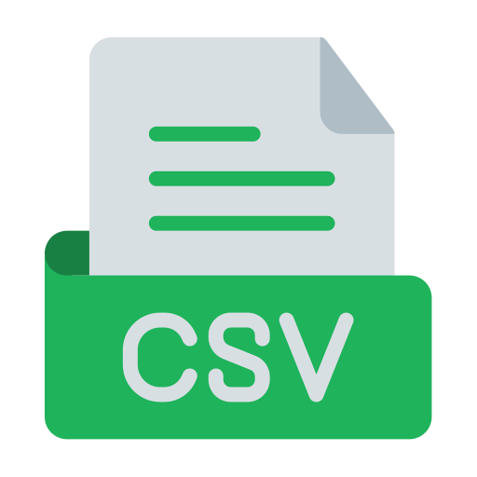
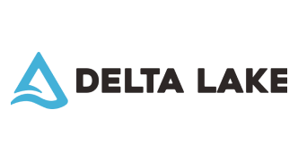

Medallion Architecture
INGEST
LANDING
ZONE
PREPARE
BRONZE
PROCESS
SILVER
ENRICH
SILVER
SERVE
GOLD
STORE (AZURE DATA LAKE STORAGE GEN2)
Notes:
Data will be extracted from Dynamics NAV/BC and stored within the data lake using a medallion architecture, following the recommended best practice for lakehouses.
The medallion architecture is a crucial concept for the creation of a lakehouse. It allows source system abstraction, provides the ability to build complex enterprise data models, and abstracts away complexity and internal logic from data consumers. Hosting data in this architecture guarantees atomicity, consistency, isolation, and durability (ACID) capabilities as data passes through multiple layers of validation and transformation before being stored in a layout optimized for efficient analytics. As data moves from ingestion, it is curated and refined, going through various processing and enrichment steps. Information is stored along the way in different zones or layers, represented by separate storage containers within the data lake, to help avoid cloud limits on data requests. Each layer of the architecture describes the quality of the data it hosts.
It includes a landing zone for raw data in its original format, a bronze layer for raw data converted into a standardized and compressed file format, a silver layer for cleaned and formatted data, and a gold layer for business aggregates and data models for BI. As data is refined and moved through the different layers in the architecture, various file formats will be used for storing it. The file formats that will be used include:
The comma-separated value (CSV) file format will be used for storing raw data extracted from source systems in the landing zone.
Parquet, a very efficient, compressed columnar file format, will be used to store prepared data in the bronze layer. Parquet files can be partitioned but are immutable, meaning the data contained within them cannot be edited. This restriction also means merging incremental changes into the files is impossible.
Delta tables, which are versioned parquet files with transaction logging and ACID capabilities, will be used for data in the silver and gold layers of the architecture. Delta allows update and delete operations to be applied to the underlying parquet files.
The suggested approach makes use of the following layers or zones:
Landing zone:
The landing zone layer is the repository for unvalidated, raw data ingested from source systems. It provides a location for storing data in the format used when extracted from its source, typically CSV files for data from relational databases. Data stored in the landing zone is not cleaned or transformed, providing future access to raw data as it was extracted from the source system.
This layer allows the system to retain the entire, unprocessed history of each dataset in an efficient storage format, providing the ability to recreate any state of a given data system.
Bronze layer:
Files in the bronze layer reflect the first step in preparing data for downstream consumption. Data preparation includes standardizing data from the landing zone into the parquet file format and writing those files into the folder structures that will be used for further data processing. Data in the bronze layer represents a reformatted version of raw data.
Silver layer:
The silver layer hosts data curated or refined through various processing and enrichment steps based on business-critical logic and data consumption requirements. When writing data into the silver zone, the goal is to validate, cleanse, standardize, and enrich ingested data from the bronze layer. Data deduplication is also performed on data going into the silver zone. The data in this layer represents a validated, enriched version of our data, providing a trusted foundation for downstream analytics and creating business-oriented data models in the gold layer.
Data in this layer should be presented in different perspectives called data marts to accommodate various user groups and data consumption requirements. One data mart should be designed for each end consumer group to make data easy to consume, manage, and secure.
Gold layer:
Data in the gold layer represents transformations, aggregations, and enrichments applied to data, which is often highly refined and aggregated, containing data used to power analytics, machine learning, and production applications. Gold tables represent data transformed into knowledge rather than just information. The data in this layer will be served up to end-user reporting tools, such as Power BI, and other analytics tools for making business decisions.

Slide 18
Loading data into the data lake: ingest and prepare
Gather data
Examine data
Store in native format
Standardize data
Notes:
Data ingestion, just as it sounds, is the process of gathering data of any format from various systems, whether they be on-premises, in the cloud, an API, or any other source, and copying it into a centralized location.
Data discovery, exploration & preparation:
Part of gathering data is integrating with our data sources as a starting point for our data pipeline.
Before we can work with the ingested data, we need to examine the data, and set up some standards for the data we plan to work with.
Data coming from different sources needs to be put into a common format.
Data types and column names need to be standardized.

Slide 19
Describe Delta Lake architecture
4

Slide 20
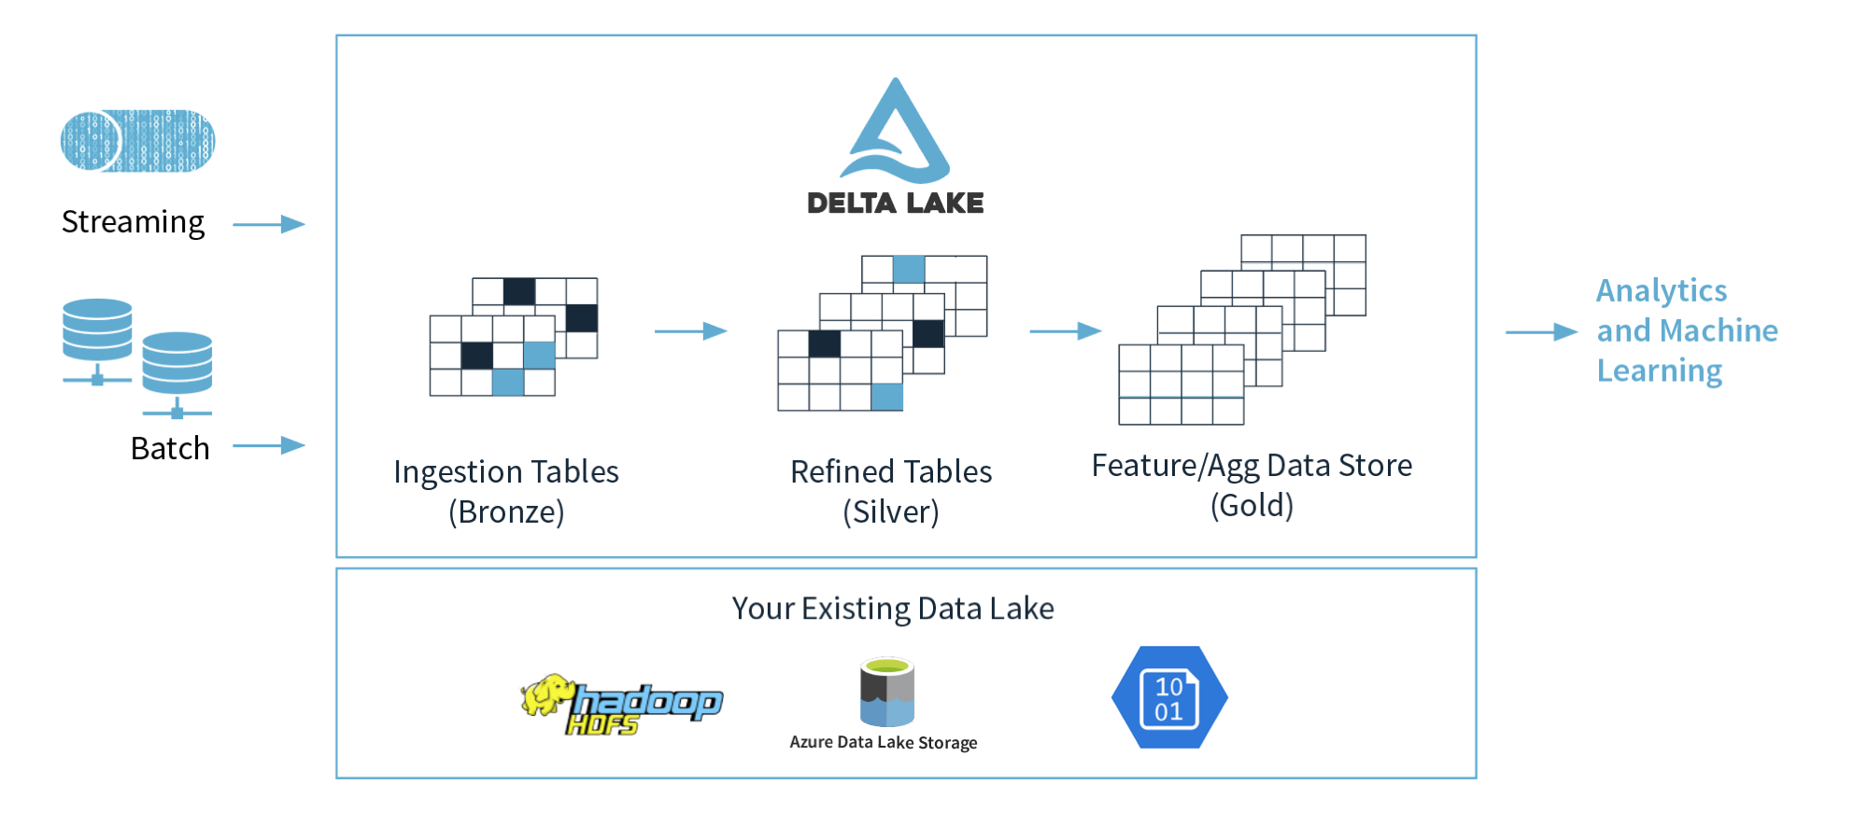
Describe a Delta Lake architecture
Notes:
Talking points
The Delta Lake Architecture is a vast improvement upon the traditional Lambda architecture. At each stage, we enrich our data through a unified pipeline that allows us to combine batch and streaming workflows through a shared filestore with ACID-compliant transactions.
Delta Lake is an open-source storage layer that brings ACID (atomicity, consistency, isolation, and durability) transactions to Apache Spark and big data workloads. The current version of Delta Lake included with Azure Synapse has language support for Scala, PySpark, and .NET. It is also supported on Azure Databricks. Using delta lake in a well-organized data lake can aid the integrity and performance of both batch and streaming data solutions. The common misconception made with Delta lake is that people think it is a data platform service. It’s not. It is simply a format that is defined when you create a DataFrame against the storage layer, and this is what brings the ACID capabilities to the data held in the DataFrames. Couple this with organizing the folders in an appropriate way, then you have an approach that can scale in an organized way that prevents your data lake becoming a data “swamp”.
In the example above, the data lake is organized using the bronze, silver and gold architecture. The input method is irrelevant, it can either be a streaming solution, or a batch solution. Essentially, we organise our data into layers, or folders as defined as bronze, silver and gold as follows:
Bronze - tables contain raw data ingested from various sources (JSON files, RDBMS data, IoT data, etc.).
Silver - tables will provide a more refined view of our data. We can join fields from various bronze tables to enrich streaming records, or update account statuses based on recent activity.
Gold - tables provide business level aggregates often used for reporting and dashboarding. This would include aggregations such as daily active website users, weekly sales per store, or gross revenue per quarter by department.
The end outputs are actionable insights, dashboards, and reports of business metrics.
Instructor notes and guidance
While this is an open-source technology that is not covered by the exam objectives, it is an important area that is growing in the data engineering world and being seen by some data engineers as an architecture to replace the lambda architecture model. It is also covered in depth in the lab as we explore Azure Databricks implementing the delta lake architecture in the data lake store. In the lab, you will explore this architecture being created using Azure Databricks, but it could be done in Azure Synapse Analytics too.
You should call out the common misconception laid out in the talking points above. Make sure your students understand that Delta Lake if a format. Not a service.
Recommended reading for this slide
Describe Azure Databricks Delta Lake architecture - Learn | Microsoft Docs
Build and query a Delta Lake - Learn | Microsoft Docs

Slide 21
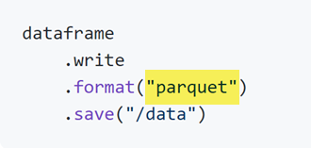
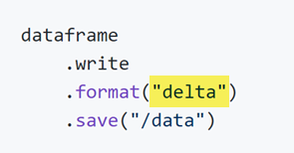
How to use Delta format
…simply create a table using delta
Instead of creating a table using parquet…

Slide 22
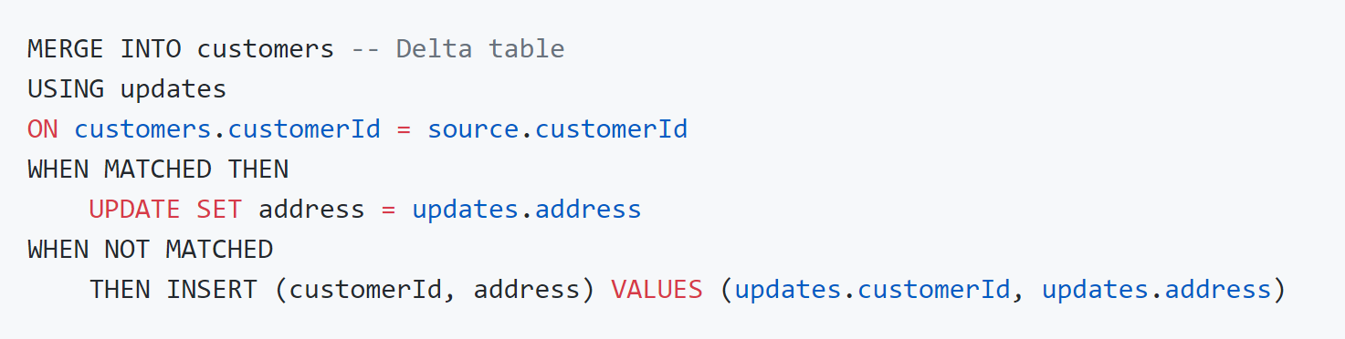
Upsert syntax
Notes:
To UPSERT means to "UPdate" and "inSERT". In other words, UPSERT is literally TWO operations. It is not supported in traditional data lakes, as running an UPDATE could invalidate data that is accessed by the subsequent INSERT operation.
Using Delta Lake, however, we can do UPSERTS. Delta Lake combines these operations to guarantee atomicity to
INSERT a row
if the row already exists, UPDATE the row.

Slide 23
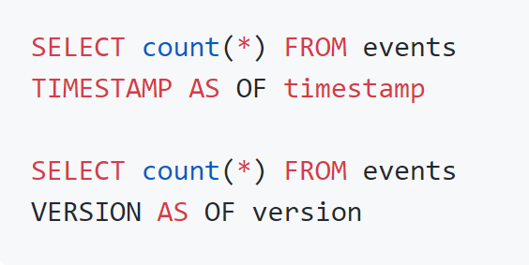
Time travel syntax
Basic syntax using SQL:
Load an older version:
Notes:
Because Delta Lake is version controlled, you have the option to query past versions of the data. Using a single file storage system, you now have access to several versions your historical data, ensuring that your data analysts will be able to replicate their reports (and compare aggregate changes over time) and your data scientists will be able to replicate their experiments.
Other time travel use cases are:
Re-creating analyses, reports, or outputs (for example, the output of a machine learning model). This could be useful for debugging or auditing, especially in regulated industries.
Writing complex temporal queries.
Fixing mistakes in your data.
Providing snapshot isolation for a set of queries for fast changing tables.
If you want to access the data that you overwrote, you can query a snapshot of the table before you overwrote the first set of data using the versionAsOf option.
You should see the first set of data, from before you overwrote it. Time travel takes advantage of the power of the Delta Lake transaction log to access data that is no longer in the table. Removing the version 0 option (or specifying version 1) would let you see the newer data again.

Slide 24
Indexing with Hyperspace
5
Notes:
TALKING POINTS
Let’s go over fundamental data modeling for optimizing analytical workloads. How many of you have heard of a star or snowflake schema?
PRESENTER NOTES AND GUIDANCE
Poll your audience.

Slide 25
Hyperspace: An indexing subsystem for Apache Spark
Hyperspace helps accelerate workloads under two circumstances:
Queries contain filters on predicates with high selectivity
Queries contain a join that requires heavy shuffles
Notes:
Hyperspace introduces the ability for Apache Spark users to create indexes on their datasets, such as CSV, JSON, and Parquet, and use them for potential query and workload acceleration.
Hyperspace helps accelerate your workloads or queries under two circumstances:
Queries contain filters on predicates with high selectivity. For example, you might want to select 100 matching rows from a million candidate rows.
Queries contain a join that requires heavy shuffles. For example, you might want to join a 100-GB dataset with a 10-GB dataset.
Given these restrictions, you will want to carefully monitor your workloads and determine whether indexing is helping you on a case-by-case basis.

Slide 26
LAB 25: Use Delta Lake in Azure Databricks
60 minutes
Notes:
TALKING POINTS​
​
Let’s put this into reality and show you how it works.​
​
All instructions and context are found in this repository​

